Slide 1

Review of Version 1

Slide 2
Implementation Features

Slide 3
Multi-Page Navigation
Implemented a session-based navigation system across three pages:
Upload Cost Data
Upload Attribute Data
View Charts.

Slide 4
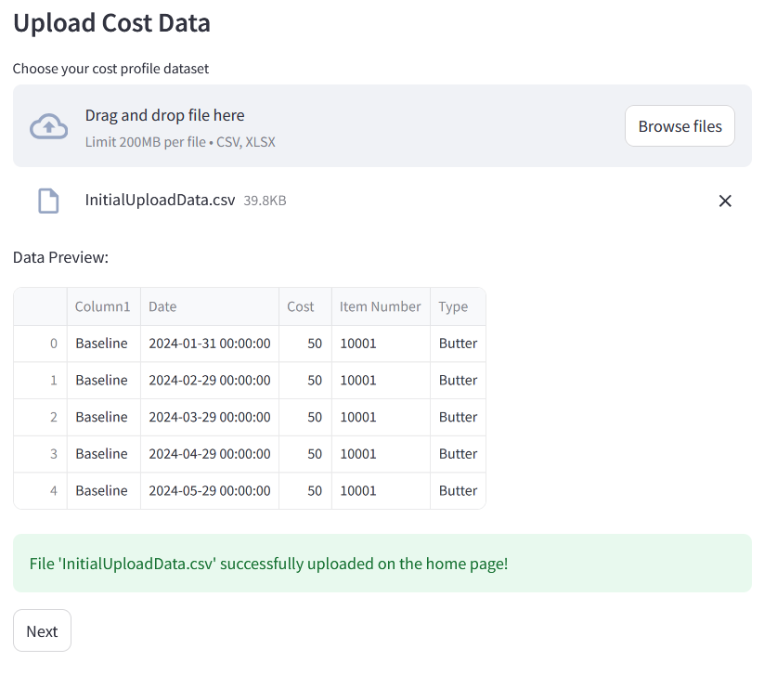
Data Upload & Validation
Enables users to upload cost profiles and attribute data
Validate the Data
Previews uploaded files

Slide 5
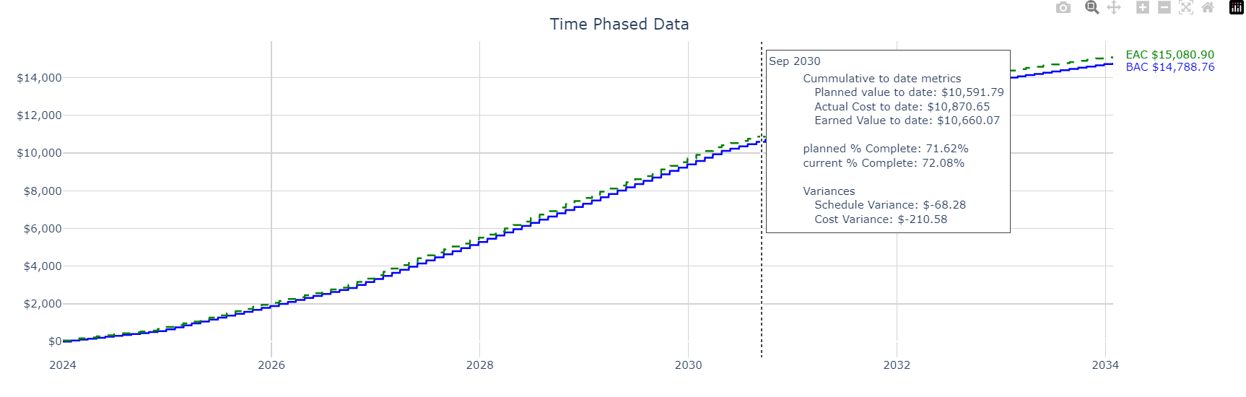
EVM Calculations and Visualization
Visualizations to compare baseline vs. modified costs
Cumulative line chart
Bubble charts
Core EVM metric calculations are displayed
Cumulative metrics (EAC and BAC)
Time phased metrics (PV, EV, CV, SV, PV, EV, and CV)

Slide 6
Remaining Features

Slide 7
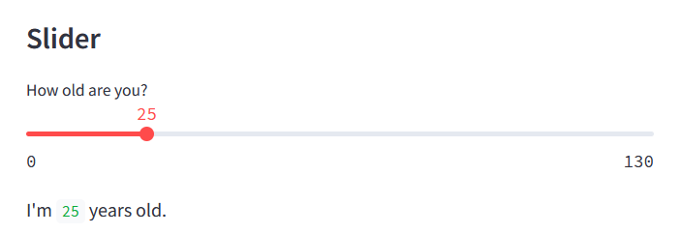
Add slide bars or user input
Add sliders to enable user input that modifies the output data
Should have an initial value that aligns with the attribute data
Should show the user the percent impact and what is impacted as they move the scale
If feasible, it should have the ability to update the plots in live time

Slide 8
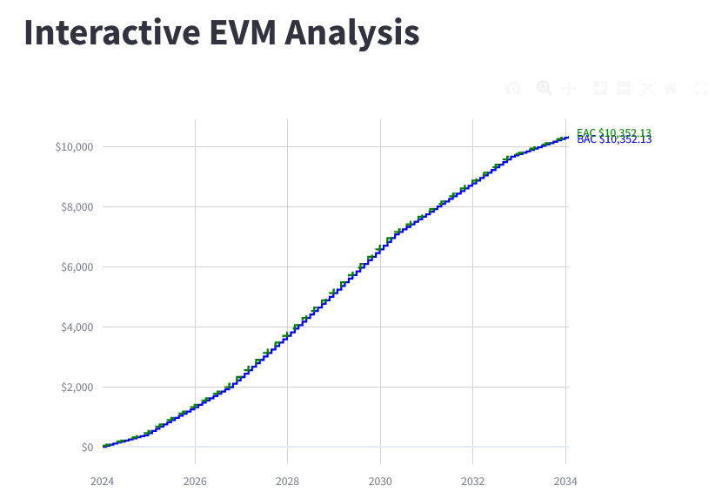
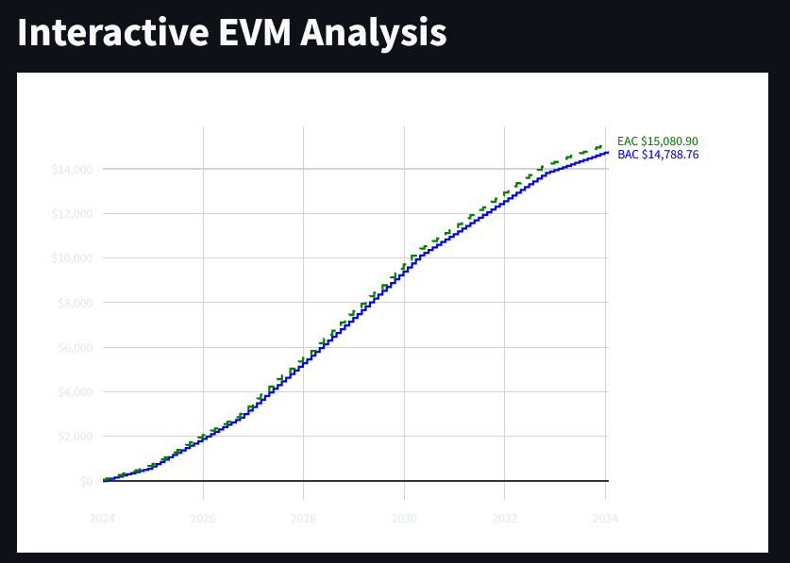
Refine Graphics
Currently the graphics don’t display well and need to be further refined
Particularly with dark mode

Slide 9
Optional: Compare two files
Users may want to compare this same type of data between two files. Could provide the same charts comparing two data files instead as an additional mode

Slide 10
Issues and Solutions

Slide 11
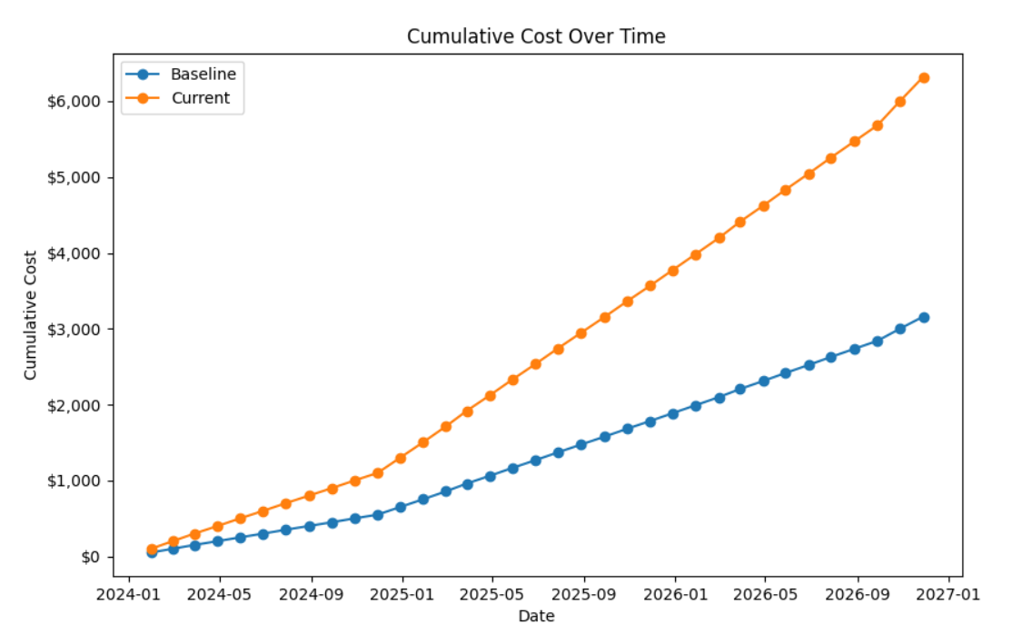
Starting with Matplotlib
Unable to create nice aesthetics with hovering annotations
Couldn’t find a solution to having a vertical line that could be used to select certain dates to evaluate EVM metrics over time

Slide 12
Transitioned to Pyplot
Annotations are more customizeable
Found a solution for users to mouse over a time, see a vertical bar, and the EVM metrics for that time period
Legend and other elements are highly customizeable

Slide 13
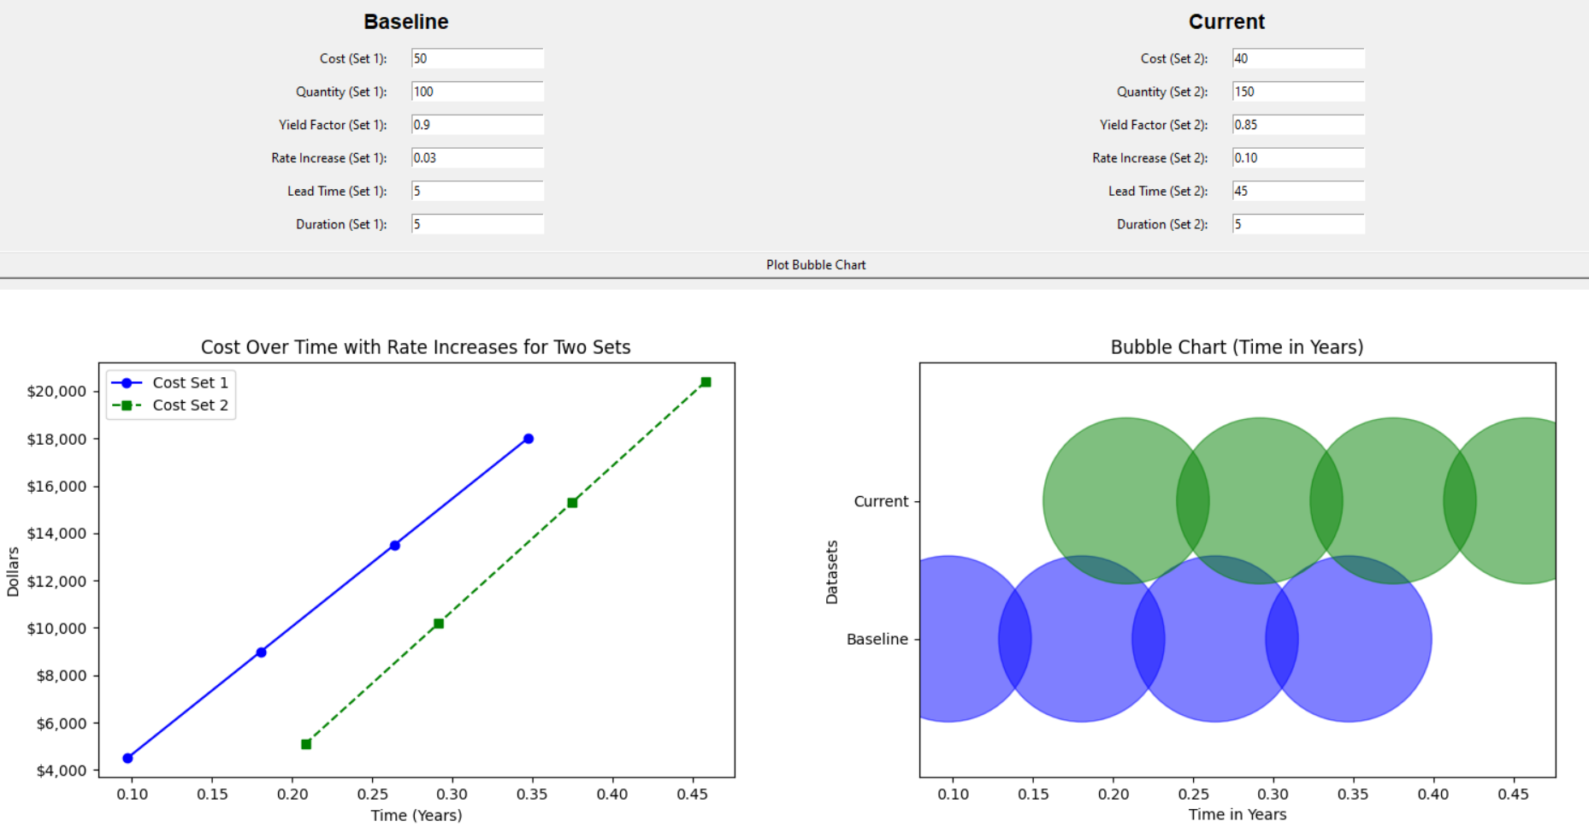
Started with Tkinter for the UX
Started with Tkinter out of familiarity
Struggled to get it to look nice aesthetically and quickly opted for functionality
While it worked with Matplotlib it is not compatible with Pyplot

Slide 14
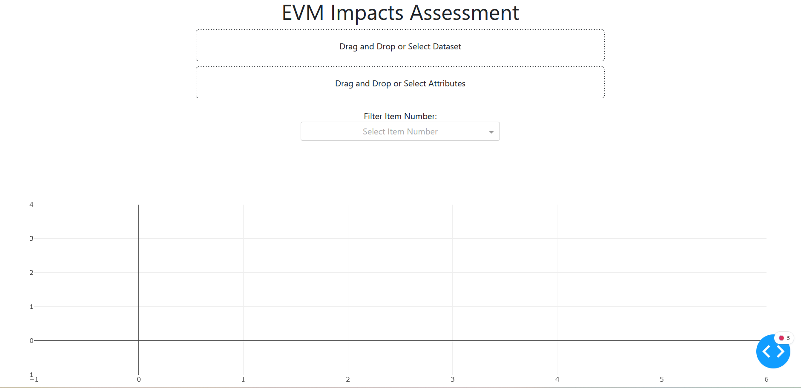
Experimented with Dash
Dash is part of the same library as Pyplot and seemed like a good option
Slider bar functionality seemed limited

Slide 15
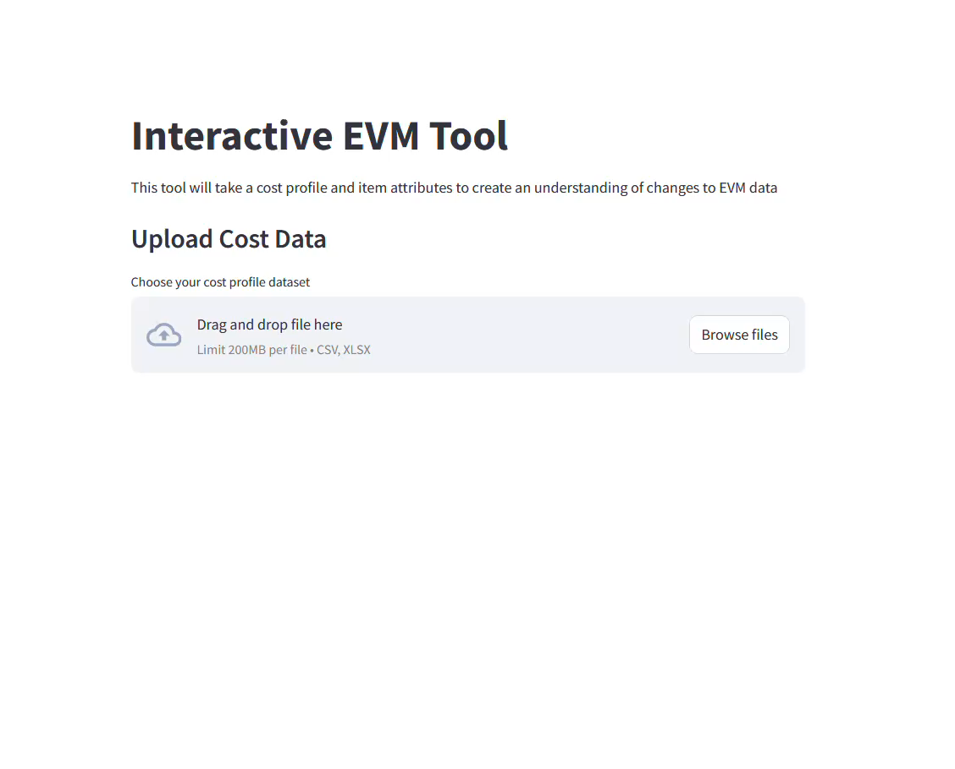
Decided to use Streamlit
provided both flexibility in UI design and ease of integration with plotting libraries like Plotly. It allowed me to build a responsive and clean interface for the EVM tool.

Slide 16
Other Obstacles That were Overcome
Organization of the code started off very poor
Curiosity and trying out several different approaches created a confusing mess of files and functions
Decided to create a new file and take a more methodical approach once establishing Pyplot and streamlit would be my primary libraries
Difficulty in debugging efficiently (thank you for the great tips)

Slide 17
Outstanding Issues
Dark mode view is unreadable with the axis
Thank you for the feedback and tips on this
Currently the transition to the chart page is slow
Shows artifacts from the previous page before it finishes rendering
Can reduce dataset being processed, currently looks at each day for data but can be cumulative over a month
Concern with speed as user updates slider values once the functionality is added
Currently takes a while to render the chart
If it is too slow, will have to implement a button that updates the charts on user request rather than instantly

Slide 18
Milestones

Slide 19
Future Milestones
Add slider bars or way for users to interact with the data
Modify the plotted data to summarize data by month rather than by day to reduce the size
Refine the charts to be more readable
Deploy the App
Complete Documentation

Slide 20
Reflections
Satisfaction with Progress
I’m generally satisfied with my progress, especially after finding Streamlit, which has been a game-changer for my project.
Expectations vs. Reality
I underestimated how challenging it would be to find the right tools. I also didn’t anticipate how much time I would need to spend on organizing the project.
Lightbulb Moment
Realizing that I needed to step back and take a more methodical approach to organize the app was crucial.
Another key moment was discovering Streamlit’s flexibility, which perfectly suited my project’s needs for both visualization and UI control.

Slide 21
Thank you

